Slide 1
Predicting Hospital Star Ratings from Quality and Safety Indicators
A leakage-free machine learning pipeline on the CMS Hospital Information dataset
Logistic Regression | Decision Tree | Random Forest
Saniya Sheikh | 23070521127 Suhani Chafale | 23070521154
Project report presentation

Slide 2
Why Study Hospital Star Ratings?
The CMS Overall Hospital Quality rating (1 to 5 stars) summarises 57 measures across 7 domains: mortality, safety of care, readmission, patient experience, effectiveness, timeliness and imaging use.
Research question
How much signal do coarse national-comparison categories (above / same / below average) and a few hospital attributes carry about the star rating?
Consumers use it to choose hospitals; providers use it to guide quality improvement.
Prior work shows scores cluster near the middle of the scale and are weak proxies for condition-specific performance. Open-source tools can reproduce the rating from exact measure data.
Our approach
Compare three classifiers, engineer a composite quality-safety score, and evaluate with per-class metrics.

Slide 3
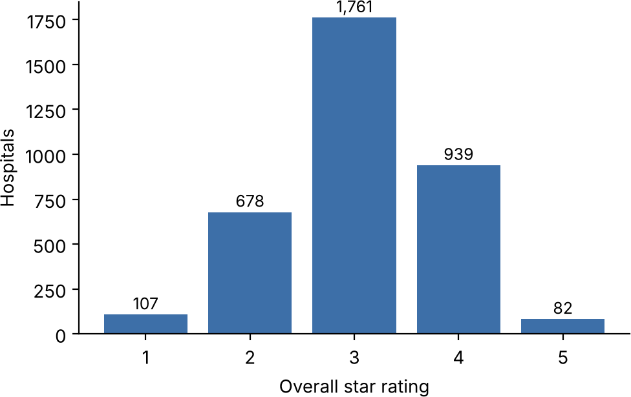
Dataset and Cleaning
Source: Hospital Information dataset (Kaggle): 4,812 records, 29 columns.
Target: overall rating 1 to 5. Records without a rating removed, leaving 3,567 hospitals.
Footnote columns (55-79% empty) dropped.
EHR flag has a single value (true), so it has no discriminating power.
Heavily skewed toward 3 stars (49.4%); only 107 one-star and 82 five-star hospitals, so class weighting and per-class evaluation are needed.
Class distribution after cleaning (N = 3,567)

Slide 4
Methodology and Feature Engineering
HospInfo.csv
4,812 records
>
Cleaning
3,567 rated
>
Features
13 inputs
>
80/20 split
stratified
>
Preprocess
fit on train only
>
3 models
LR, DT, RF
Engineered Healthcare Quality-Safety Score
Each indicator label is mapped to +1 (above), 0 (same) or -1 (below the national average); "Not Available" stays missing.
13 model inputs
Group | Count
Hospital attributes (type, ownership, emergency, EHR) | 4
National-comparison indicator labels | 7
Score S_i and indicator count n_i (numeric) | 2
S_i = (1 / |K_i|) * sum of s_ik over observed indicators n_i = |K_i| (number of available indicators, up to 7)
Leakage-free: imputation, scaling and one-hot encoding live inside a ColumnTransformer fitted on training data only, so test data never influences preprocessing.

Slide 5
Classification Models and Setup
Model Key settings
Logistic Regression Multinomial softmax, L2 penalty (C = 1.0), balanced class weights, max_iter 2000 Decision Tree Weighted Gini impurity, max_depth 8, min_samples_leaf 5, balanced weights
Random Forest 300 trees, max_depth 12, min_samples_leaf 3, balanced weights, majority vote
Experimental protocol
Stratified 80/20 split, random seed 42: 2,853 training and 714 test hospitals.
Class weight w_{c} = N / (K x n_{c}) to counter the 3-star dominance. Hyperparameters fixed a priori; no tuning or cross-validation.
Metrics: accuracy, weighted precision / recall / F1, plus per-class scores and confusion matrix. Run in Google Colab with scikit-learn, pandas, NumPy.

Slide 6
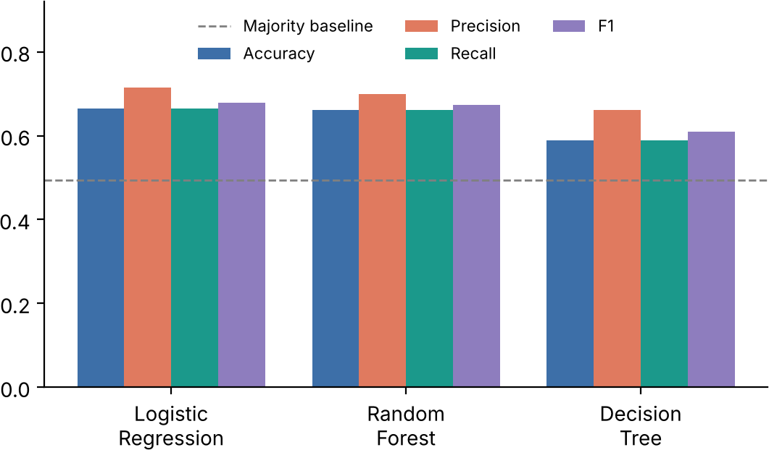
Model Comparison
Model | Accuracy | Precision | Recall | F1
Logistic Regression | 0.664 | 0.714 | 0.664 | 0.678
Random Forest | 0.661 | 0.699 | 0.661 | 0.673
Decision Tree | 0.588 | 0.660 | 0.588 | 0.609
Majority class | 0.494 | - | - | -
Logistic Regression and Random Forest are statistically indistinguishable: the accuracy gap is 0.003, about two hospitals out of 714. Both clearly beat the Decision Tree and the majority baseline.
Random Forest was chosen for error and importance analysis because of its built-in feature importances.

Slide 7
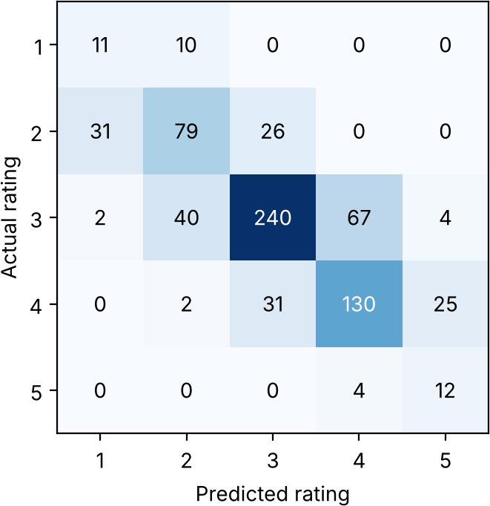
Error Analysis (Random Forest)
472 of 714 hospitals (66.1%) lie on the diagonal.
Errors are almost always one star away; only 8 of 242 errors span two stars. Balanced weights give high recall on rare extremes at the cost of precision.
Stars | Precision | Recall | F1 | Support
1 | 0.25 | 0.52 | 0.34 | 21
2 | 0.60 | 0.58 | 0.59 | 136
3 | 0.81 | 0.68 | 0.74 | 353
4 | 0.65 | 0.69 | 0.67 | 188
5 | 0.29 | 0.75 | 0.42 | 16
Macro avg | 0.52 | 0.65 | 0.55 | 714
Weighted avg | 0.70 | 0.66 | 0.67 | 714

Slide 8
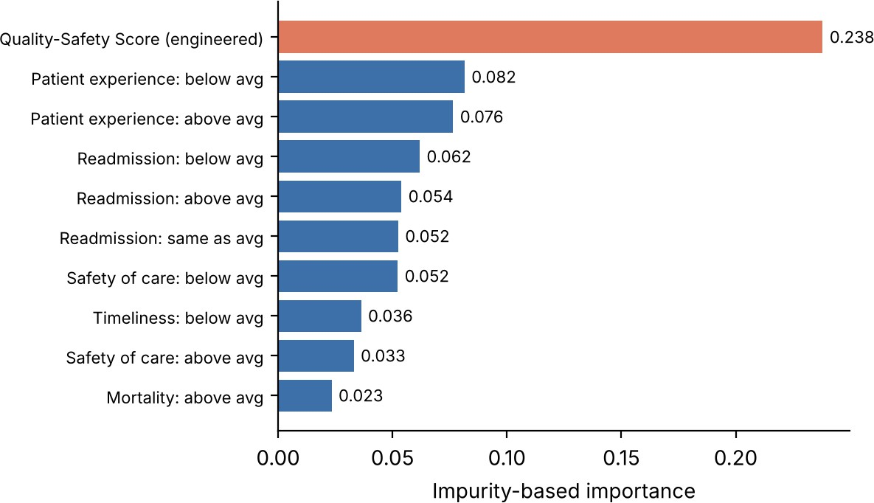
What Drives the Prediction?
The engineered Quality-Safety Score is the top feature (0.238), about 3x the next one.
Patient experience and readmission categories follow.
Hospital type, ownership and emergency services are not in the top 15.
Importance shows association, not causal effect, and can favour features with many split points.

Slide 9
Ablation and Literature Context
Effect of the engineered features (Random Forest)
Feature set | Accuracy | F1
Original 11 categorical features | 0.643 | 0.656
+ Quality-Safety Score and count (13) | 0.661 | 0.673
+1.8
points accuracy
+1.8
points weighted F1
Single split with fixed seed: a consistent benefit, but not statistically tested.
How this compares with prior work
Locey et al. reproduced the CMS rating with 99.6% accuracy using full numeric measures. Our ~66% reflects having only 7 coarse categories.
Kurian et al. used ordered logistic regression; our regularised linear model is analogous.
Tabular-data studies favour trees and linear models at ~3.6k samples; a linear model matching a 300-tree forest suggests the ordinal relationships are fairly linear.

Slide 10
Limitations and Conclusion
Limitations and future work
One stratified split; no cross-validation or tuning, so small gaps are not meaningful.
1,245 unrated hospitals omitted; one U.S. data release only.
Engineered score compresses the same labels, adding no new information.
Next: k-fold CV, ordinal and cost-sensitive models, gradient boosting, calibration, SHAP, numeric indicators.
Conclusion
A leakage-free pipeline predicts hospital star ratings from coarse quality and safety categories.
Logistic Regression (66.4%, F1 0.678) and Random Forest (66.1%, F1 0.673) clearly beat the Decision Tree (58.8%) and the majority baseline (49.4%).
Errors fall mainly between adjacent star ratings; extreme ratings remain hard.
The Quality-Safety Score is the most important feature and lifts accuracy.

